Slide 1
SINGLETON PATTERN
Emre Işın

Slide 2
Definition
With the Singleton design pattern you can:
  Ensure that only one instance of a class is created.
  Provide a global point of access to the object.

Slide 3
Why We Use
  creating lots of objects can take a lot of time
  extra objects take up memory
  it is a pain to deal with different objects floating around if they are essentially the same

Slide 4
Motivation
We are taking a class and letting it manage a single instance of itself. We are also preventing any other class from creating a new instance on its own.
Whenever you need an instance, just query the class and it will hand you back the single instance.

Slide 5
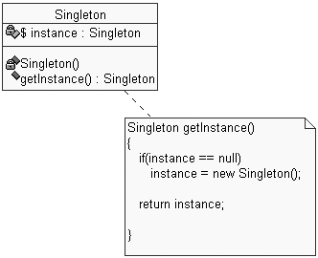
Motivation

Slide 6
Implementation
Make constructor private so they can not be called from outside.
Declare a single static private instance of the class.
Write a public method (Ex:getInstance()) that allows access to the single instance.

Slide 7
Let’s make some examples:
  SimpleSingleton.java
  Singleton.cs

Slide 8
What about if multiple thread is used?
  SingletonWithMultipleThread.java

Slide 9
QUESTIONS?

Slide 10
Reference
http://en.wikipedia.org/wiki/Singleton_pattern
http://www.javaworld.com/javaworld/jw-04-2003/jw-0425-designpatterns.html
http://serkank.wordpress.com/2009/04/16/singleton-pattern-uzerine/

